Slide 1
Windows 7
Building a Multi-Touch Enabled Point of Sales System

Slide 2
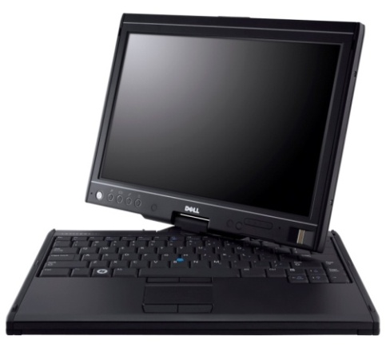
The Changing Paradigm
Hardware available!
Consumers accustomed to mobile touchscreens
Windows 7
.NET 4
Notes:
The idea of tablet PCs has been around for a while. I recall attending sessions in 99 or 2000 with Bill Gates advocating this idea. However, it took a decade for the price and size of hardware to become reduced enough for it to truly catch on.

Slide 3
Themes
Closest for the Touch style
Cosmopolitan
tinyurl.com/cosmotheme
MetroToolkit
metrotoolkit.codeplex.com

Slide 4
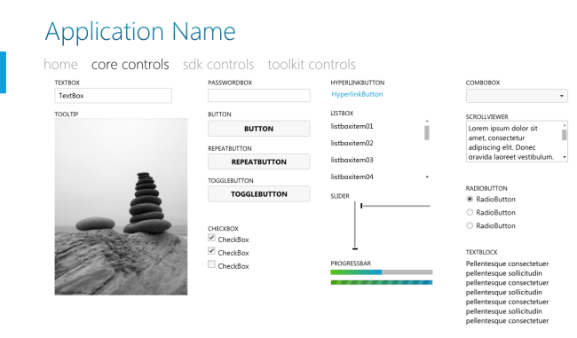
Cosmopolitan Theme

Slide 5
Theme
Cosmopolitan
tinyurl.com/CosmopolitanTheme

Slide 6
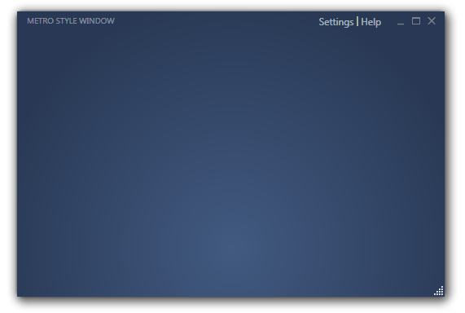
Metro Theme

Slide 7
Theme
Metro
metrotoolkit.codeplex.com

Slide 8
Styling
Design for the finger, not the cursor
Larger is better
Lessons from the phone

Slide 9
DEMO
Styling

Slide 10
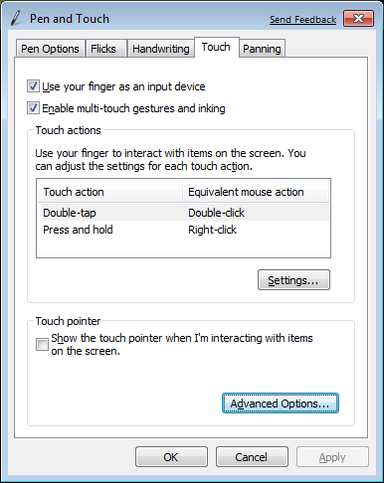
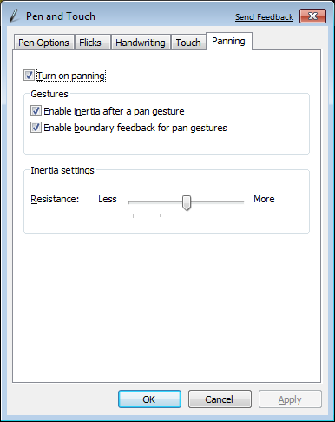
Configuration

Slide 11

Accepting Input
Notes:
Attribution: http://www.flickr.com/photos/webhamster/2476756607/

Slide 12
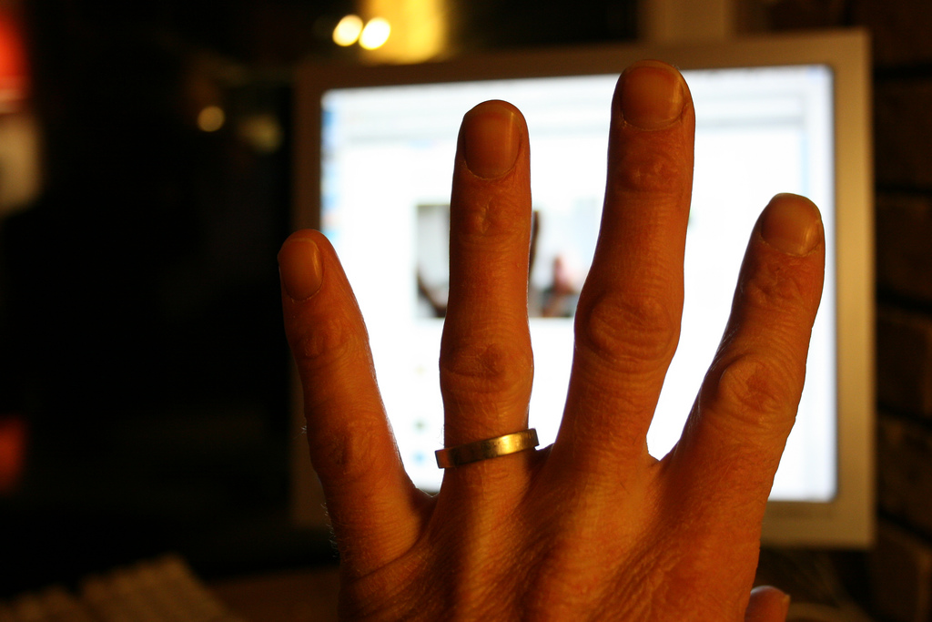
Accepting Input
Notes:
Attribution: http://www.flickr.com/photos/silverfox09/2404140958

Slide 13
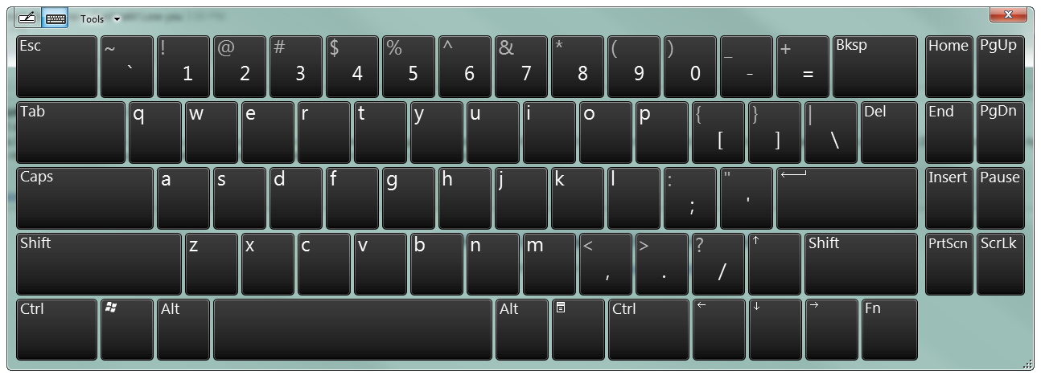
Accepting Input

Slide 14
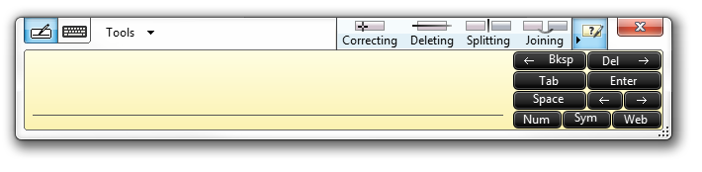
Accepting Input

Slide 15
DEMO
Input

Slide 16
Taking advantage of Multitouch
APIs
Native Win32
WinForms
WPF

Slide 17
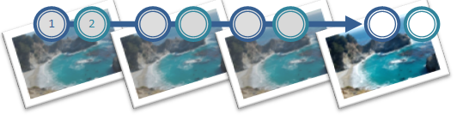
Predefined Gestures
Panning
Place two fingers in the application window and drag in the direction you want

Slide 18
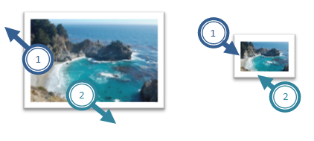
Predefined Gestures
Zoom
Touch the image with two fingers and move them closer or further apart

Slide 19
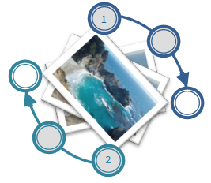
Predefined Gestures
Rotate
Touch the image with two fingers and turn fingers in a circle

Slide 20
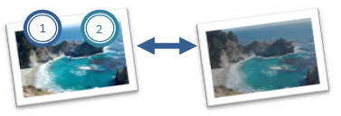
Predefined Gestures
Two Finger Tap
Tap once with both fingers

Slide 21
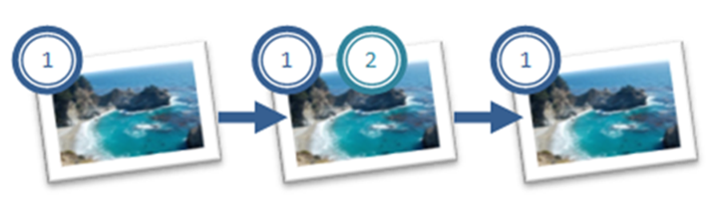
Predefined Gestures
Finger Roll
Place one finger on the screen, place second finger on the screen, lift the second finger, and then lift the first finger

Slide 22
Considerations
Support for non-touch devices
Natural interaction
Established gestures

Slide 23
DEMO
Implementing WPF Multitouch

Slide 24
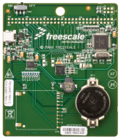

Sensor and Location Platform
Gadget or script
Application
Application
Location IDispatch Interface
Location API
Sensor API
User
Location and Other Sensors Control Panel
System
Sensor class extension
Sensor class extension
UMDF sensor driver
UMDF sensor driver
Logical location sensor
(Triangulation)
Sensor
device

Slide 25
Where am I?
Single call
Provider independent
Uses most accurate provider
Synchronous or asynchronous
Code, script, or automation
Default location

Slide 26
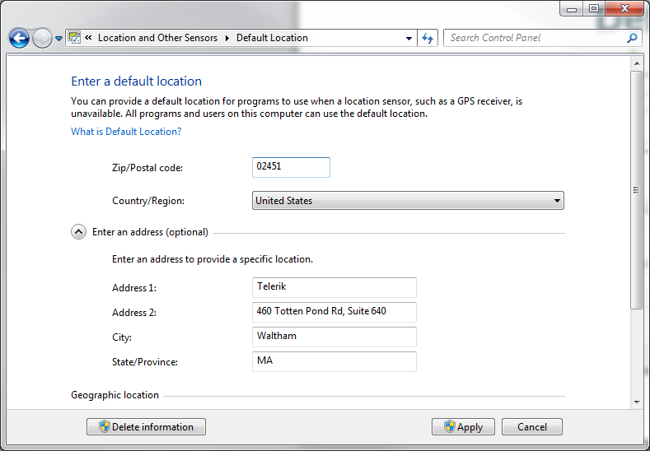
Default Location

Slide 27
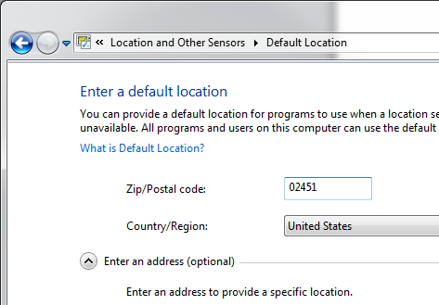
Default Location
Control Panel

Slide 28
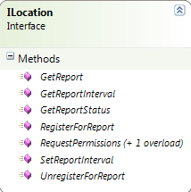
Location API Architecture
Get Location Report
Synchronous
Register for Notification
Asynchronous
Query Status
Request Permissions

Slide 29
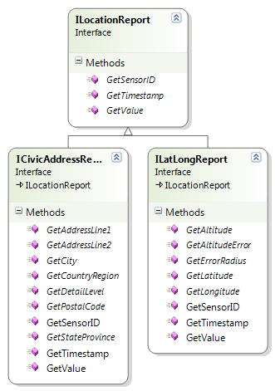
Location API Architecture
ILatLongReport
Lat, Long, Altitude
Most Common
Precise
ICivicAddressReport
Zip Code, Country Required
Human Readable
Rough Estimates

Slide 30
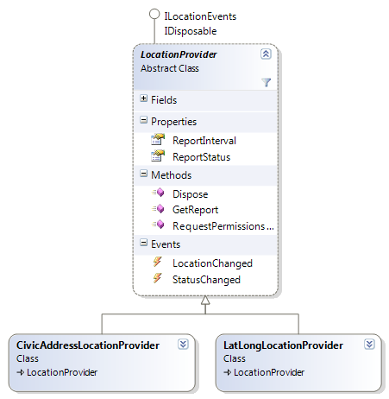
Location Wrapper
Instantiate desired provider
Query status
GetReport()
Subscribe to LocationChanged

Slide 31
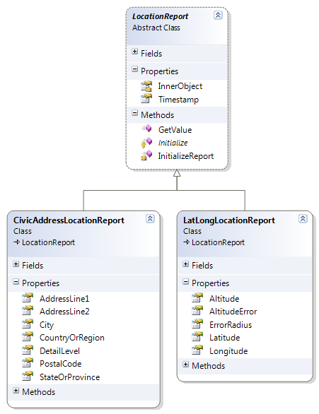
Location Wrapper
Contains retrieved data
Cast to appropriate type
Use properties for information

Slide 32
Location Wrapper
Sensor and Location .NET Interop Sample Library
tinyurl.com/LocationWrapper

Slide 33
DEMO
Implementing Location Services

Slide 34




Resources
Software Application Developers
Infrastructure Professionals
http://msdn.microsoft.com/
http://technet.microsoft.com/
msdnindia
technetindia
@technetindia
@msdnindia

Slide 35

© 2011 Microsoft Corporation. All rights reserved. Microsoft, Windows, Windows Vista and other product names are or may be registered trademarks and/or trademarks in the U.S. and/or other countries.
The information herein is for informational purposes only and represents the current view of Microsoft Corporation as of the date of this presentation. Because Microsoft must respond to changing market conditions, it should not be interpreted to be a commitment on the part of Microsoft, and Microsoft cannot guarantee the accuracy of any information provided after the date of this presentation. MICROSOFT MAKES NO WARRANTIES, EXPRESS, IMPLIED OR STATUTORY, AS TO THE INFORMATION IN THIS PRESENTATION.

